Slide 1
OpenDSS Training Workshop
Introduction to OpenDSS
Roger C. Dugan
EPRI Knoxville, TN
August 22, 2022

Slide 2

Instructor
Roger C. Dugan, Life Fellow, IEEE
Roger is a Sr. Technical Executive with EPRI in Knoxville, Tennessee USA. He has over 50 years of combined experience in distribution engineering with EPRI, Electrotek Concepts, and Cooper Power Systems. He holds the BSEE degree from Ohio University and the Master of Engineering in Electric Power Engineering degree from Rensselaer Polytechnic Institute, Troy, NY. Roger has worked on many diverse aspects of power engineering over his career because of his interests in applying computer methods to power system simulation. Beginning with a student internship with Columbus and Southern Ohio Electric Co, his work has been focused on Distribution Engineering. He was elected a Fellow of the IEEE for his contributions in harmonics and transients analysis. Recently, he has been very active in distributed generation, particularly as it applies to utility distribution systems and distribution system analysis. He was the 2005 recipient of the IEEE Excellence in Distribution Engineering Award. He is coauthor of Electrical Power Systems Quality published by McGraw-Hill, now in its 3rd edition. He serves on the IEEE PES Distribution System Analysis Subcommittee and is active in the Distribution Test Feeders WG.

Slide 3
1. Introduction to the OpenDSS Program

Slide 4
What is the OpenDSS?
The examples in this Workshop will be taught using the EPRI OpenDSS computer program
OpenDSS is EPRI’s main tool for research involving distribution system analysis
Was made Open Source in 2008.
Over 145,000 downloads since (as of 2022).
The program is freely available and is updated regularly
You may find it on www.Sourceforge.net
Also, bookmark the EPRI link site:
https://www.epri.com/#/pages/sa/opendss?lang=en-US
This is the “jump page” for OpenDSS internet locations

Slide 5

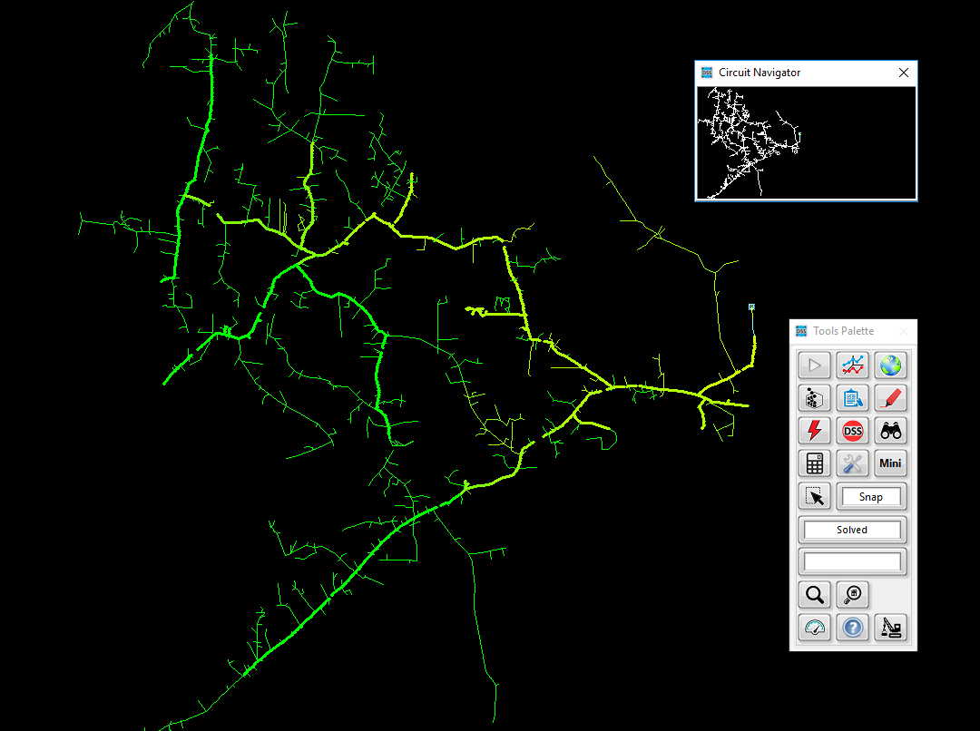
Overview of OpenDSS OpenDSS – Open-Source Distribution System Simulator
Download OpenDSS Here
Advanced distribution analysis platform that enables engineers to perform complex distribution analysis
Flexible and customizable solution designed specifically to meet the challenges facing distribution engineers
Enables engineers to easily model both traditional and advanced distribution technologies, resources, assets, and controls
Leveraged throughout the industry for modeling and simulating advanced distribution applications
Designed from the beginning to capture the time and spatial affects of distributed energy resources
Brief history and current usage
Developed/designed in 1997 to capture the time and spatial affects of distributed energy resources
Open-sourced in 2008 to coordinate and advanced smart grid assessments
Primary modeling and simulation platform used to enable execution of cutting-edge research
Notes:
OpenDSS – EPRI’s best kept secret. ☺

Slide 6
Highlighting a Few Capabilities
Grid Devices
Quasi-static time-series (QSTS)
Full library of traditional assets (lines, conductors, transformers, cap banks, switches, etc.)
Line Reg/LTC, cap banks
DER smart inverter
Solution Capabilities
Unbalanced multi-phase power flow
Fault analysis
Harmonic analysis
Controls
Energy storage dispatch
DMS/DERMS
VVO
Load models
Linear and non-linear analysis
Stray voltage/current analysis
Price modeling/dispatch
Flicker analysis
Automation
Distribution automation
Load transfers
FLISR (Fault Location, Isolation, and Service Restoration)
Solution Interfaces
Parallel processing using actors
Fast power flow
Smart inverters
Energy storage
PV systems
Wind systems
Demand response
Microgrids
DER short-ckt
Misc
Radial and networked systems
Transmission and distribution modeling
Arbitrary sized systems (single feeder to planning area)
Multithreading circuit processing
Multi-core management
DER Models
Distribution System Scripting language
Full graphical user-interface
Co-simulation capabilities
Integrated SDK for customized development
High-Performance Solutions
Notes:
Three main points
1. Wide range of capabiliites
Highlight main points
These have been added through many years of research-driven needs
2. A few we are going to be able to show
3. Some we are not:
- Distribution system scripting language
<Extra not to be discussed>
EPRI R&D and other industry partners (National Labs, universities) continue to advance the tool
Advanced capabilities fully vetted through years of user application
User-minded approach to modeling
All modeling capabilities have and continue to be developed through the years with two things in mind:
Application: How can system models/solutions be created to answer the question/issue at hand
User: how can this be modeled to enable ease of use, but flexible enough for customized analysis

Slide 7
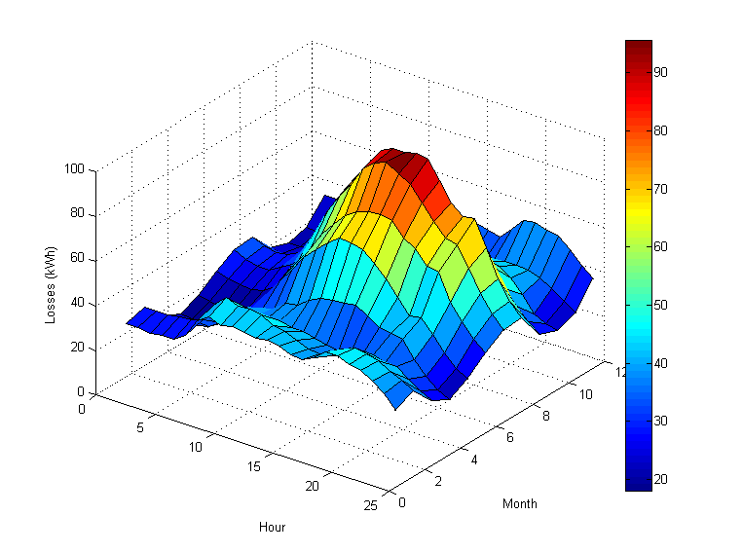
Flexible Tool Enabling a Wide Range of Analysis Types
DER Interconnection studies
Locational value studies
Hosting capacity studies
DA/FLISR scheme evaluation
Volt/var optimization
Energy impact analysis
DER protection impacts
Power quality (harmonics/flicker)
Long-range planning studies
Smart inverter control optimization
Planning for electrification
Notes:
Why do some of these things matter to you and ADP?
- Strength of DSS is it’s w

Slide 8
What is the OpenDSS?
Script-driven, frequency-domain electrical circuit simulation tool
Script with text commands
Script with another program (Python, MATLAB, C++, Delphi, etc.)
Use Windows COM interface
Use Direct DLL interface
Drive with OpenDSS-G
Specific models for:
Supporting utility distribution system analysis
Designed for the unbalanced, multi-phase North American power distribution systems
Can model European-style systems also
These typically have a simpler structure

Slide 9
What is the OpenDSS? (cont’d)
Heritage
Harmonics solvers rather than power flow
Gives OpenDSS extraordinary distribution system modeling capability
Simpler to solve power flow problem with a harmonics solver than vice-versa
More like EMT or Dynamics model than typical Distribution Power Flow
Supports all rms steady-state (i.e., frequency domain) analyses commonly performed for utility distribution system planning
And many other types of analyses
Original purpose: DG interconnection analysis

Slide 10
What is the OpenDSS? (cont’d)
What it Isn’t
An Electromagnetic transients (EMT)solver (Time Domain)
It can solve Electromechanical transients
Frequency Domain => “Dynamics”
All solutions are in phasors (complex math)
Not a “Power Flow” program
Not a radial circuit solver
Does meshed networks just as easily
Not a distribution data management tool
It is a simulation engine designed to work with data extracted from one or more utility databases

Slide 11
Time- and Location-Dependent Benefits
The OpenDSS was designed to capture both
Time-specific benefits and
Location-specific benefits
Needed for
DG analysis
Renewable generation
Energy efficiency analysis
PHEV and EV impacts
Other proposed capacity enhancements that don’t follow typical loadshapes

Slide 12
Time- and Location-Dependent Benefits
Traditional distribution system analysis programs
Designed to study peak loading conditions
Capture mostly location-specific benefits
Ignores time; Assumes resource is available
This gets the wrong answer for many DG, energy efficiency, and Smart Grid analyses
Must do sequential-time analysis to get the right answer
“Quasi-Static Time-Series” (QSTS) simulations
Over distribution planning area

Slide 13
What are the Key Features?
Can model virtually any distribution circuit configuration
Very flexible multi-phase transformer model
Fast and efficient QSTS simulations
Designed to allow expansion indefinitely
Impossible to anticipate everything users will want to do
Scripting language and COM interface allows easier customization
OOP design of software makes it easy to add new circuit element models
See Documentation for more details
https://sourceforge.net/p/electricdss/code/HEAD/tree/trunk/Version8/Doc/
Help menu on OpenDSS.exe
Doc folder on your OpenDSS installation
Examples folder on your OpenDSS installation

Slide 14
Controls
A key feature is that controls are modeled separately from the devices being controlled
Capacitors (CapControl element)
Regulators/tapchangers (RegControl element)
Control Modes
Static
Power flows with large time steps
Time
Control queue employed to delay actions
Control acts when time is reached
Event

Slide 15
Overall Model Concept

Slide 16
User Interfaces Currently Implemented
A stand-alone executable program (OpenDSS.exe) that provides a text-based interface (multiple windows)
Some graphical output is also provided in the base version
No graphical input is provided (use OpenDSS-G)
An in-process COM server (for Windows) that supports driving the simulator from user-written programs.
OpenDSSEngine.DLL
A direct DLL interface (OpenDSSDirect.dll) that mimics the COM interface with a standard call library
For non-Windows platforms, such as HPCs
For programming languages that do not support COM or are not efficient at supporting COM
Some users have published Python interfaces

Slide 17
DSS Structure
Scripts
Main Simulation Engine
COM Interface
User-Written DLLs
Scripts, Results

Slide 18
OpenDSS Research Directions
Exploiting high performance desktop computing to make it easier to study distribution systems of at least 100,000 nodes and as many as 1,000,000 nodes
OpenDSS Version 8 Released in 2019 (now Version 9) performs parallel processing for faster QSTS simulations
Can solve different time periods in parallel
Employs Diakoptics to solve very large networks
Improved Distribution Management Systems (DMS) functions
Several Existing EPRI research projects
Improved distribution state estimation functions
Improved microgrid simulations (Dynamics mode)
“Hot topic” currently
GIC-induced harmonics simulations

Slide 19
Built-in Solution Modes
Snapshot (static) Power Flow
Direct (non-iterative solution of I=YV )
Daily mode (default: 24 1-hr increments)
Yearly mode (default 8760 1-hr increments)
Duty cycle (1- to 5-s increments)
Dynamics (electromechanical transients – ms time steps)
Fault study
Monte carlo fault study
Harmonics
Custom user-defined solutions

Slide 20
Input Data Requirements
OpenDSS is a Script-driven circuit solution engine
The OpenDSS was designed in a research or consulting environment where input data might come from a variety of sources
The program can accept many common forms of data for describing impedances, loading, and topology of distribution systems for planning analysis
The OpenDSS scripting language is designed to require minimal translation from other formats of distribution data

Slide 21
Input Data Requirements
OpenDSS Circuit elements have many properties
The program can accept more detailed data for lines, transformers, etc. than the typical data for distribution system analysis when they are available.
Nearly all have reasonable default values
Users only need to specify the property values that are
Different than the default values, and
Used in the circuit simulation

Slide 22
Variable States and Program States
Throughout OpenDSS, property values remain at the value most recently defined until they are subsequently changed
They generally do NOT reset to original values unless you explicitly change them or Clear the circuit definition
This may be different than distribution power flow programs you are familiar with
OpenDSS is designed as an interactive simulator

Slide 23
Advanced Types of Data in OpenDSS
Harmonic spectra for harmonic analysis,
Various curves as a function of time for sequential time simulations:
Load shapes (e.g., AMI P, Q data),
Price shapes,
Temperature shapes,
Storage dispatch curves,
Growth curves.
Efficiency curves for PV inverters,
Voltage dependency exponents for loads,
Capacitor control settings,
Regulator control settings,
TCC Curves and other data for Fuse, Relay, and Recloser objects
Machine data.

Slide 24
Equations
For the curious Electrical Engineer …

Slide 25
The Math …
Nearly everything results in a matrix or array
Nodal Admittance formulation
Circuit elements modeled by primitive admittance matrices
Y_{prim}
Primitive Y matrices are used to build the System Y matrix
OpenDSS Works In
Phase domain
Actual volts and amps !!
Symmetrical components and per units not used inside the program !!
Input and output only!

Slide 26
Primitive Y Matrix
Simple Resistor

Slide 27
Primitive Y Matrix, cont’d
LINE model

Slide 28
What about 3-phase elements?
Simply let R, X, B, G, C, etc. represent 3x3 matrix
Notation stays the same
And it works!
I1, I2, V1, V2 etc become 3x1 vectors
This is basically how all the Circuit Element (CktElement class) models in OpenDSS work.

Slide 29
The Network Model
… From the program’s heritage as a Harmonics Analysis tool

Slide 30
Nodal Admittance Equations
V₁
V₂
…
V_{S}
…
V_{L1}
…
V_{L2}
…
V_{N}
I₁
I₂
…
I_{S}
…
I_{L1}
…
I_{L2}
…
I_{N}
Y_{SYSTEM}
=
N x N
(Sparse)
N = Number of NODES (not BUSES)

Slide 31
Solving the Power Flow
Once the circuit model is connected properly the next step is to Solve the base power flow
PC elements (i.e., Loads) are usually nonlinear
Loads are linearized to a Norton equivalent based on nominal 100% rated voltage.
Current source is “compensation current”
Compensates for the nonlinear characteristic
A fixed point iterative solution algorithm is employed for most solutions
This method allows for flexible load models and is robust for most distribution systems
… And is Fast!

Slide 32
Load (a PC Element)
General Concept
Added into Injection Current Vector
Goes into System Y Matrix
(One-Line Diagram)
Most Power Conversion (PC) Elements are Modeled Like This

Slide 33
Load - 3-phase Y connected
Phase 1
1
2
Phase 2
3
4 Conductors/Terminal
Phase 3
4

Slide 34
Load - 3-phase Delta connected
Phase 1
2
1
Phase 2
3
3 Conductors/Terminal
Phase 3

Slide 35
Load Models (Present version)
1:Standard constant P+jQ load. (Default)
2:Constant impedance load.
3:Const P, Quadratic Q (like a motor).
4:Nominal Linear P, Quadratic Q (feeder mix). Use this with CVRfactor.
5:Constant Current Magnitude
6:Const P, Fixed Q
7:Const P, Fixed Impedance Q
8: Special ZIP load model

Slide 36
Standard P + jQ (constant power) Load Model
When the voltage goes out of the normal range for a load the model reverts to a linear load model
This generally guarantees convergence
Even when a fault is applied !!
This script changes break points to +/- 10%:
Load.Load1.Vmaxpu=1.10
Load.Load1.Vminpu=0.90
Note: to solve some of the IEEE Radial Test feeders and match the published results, you have to set Vminpu to less than the lowest voltage published (usually about 0.80 per unit)

Slide 37
Standard P + jQ Load Model (Model=1)
Const Z
105%
(Defaults*)
95%
|I| = |S/V|
Const Z
New Method (2014)
* Change by setting Vminpu and Vmaxpu Properties

Slide 38
Power Flow Solution Algorithm
Initial Guess at Node Voltages, V
Compute all Injection (Compensation) Currents, I
For PC Elements
Solve for new guess at V
Repeat 2 and 3 until Converged
Convergence is based on change in per unit voltage magnitude
Default tolerance = 0.0001
Good enough for distribution systems

Slide 39
Putting it All Together
ALL Elements
Yprim 1
Yprim 2
Yprim 3
Yprim n
PC Elements Comp. Currents
I1
I2
Y
Node
Voltages
I_{inj}
=
V
Im
Iteration Loop

Slide 40
Putting it All Together
Th-Th-That's All Folks !
ALL Elements
Yprim 1
Yprim 2
Yprim 3
Yprim n
PC Elements Comp. Currents
I1
I2
Y
Node
Voltages
I_{inj}
=
V
Im
Iteration Loop

Slide 41
A More Concise Form …
Fixed-point solution form for normal solution
V_{n+1} = [Y_{system}]⁻¹ I_{PC}(V_{n}) n = 0, 1, 2, …
…until converged
I_{PC}(V) = compensation currents from Power Conversion (PC) elements in the circuit as a function of voltage

Slide 42
OpenDSS Solution Loop with Controls
Controls are sampled and executed after a converged power flow solution
Power Flow Solution

Slide 43
Solving the Power Flow …
This solution method requires that the first guess at the voltages be relatively close to the final solution
Not a problem for Daily- or Yearly-mode simulations
Present solution is a good initial guess at next time step
First solution is often most difficult
The solution initialization routine in OpenDSS accomplishes this with ease in most cases
Method works well for arbitrary unbalances
For conditions that are sensitive, a Newton method is provided that is slightly more robust, but slower.
Not the same as the “Newton-Raphson Power Flow” that converges on power mismatch

Slide 44
Losses are computed quite simply for any device model
Sum the powers into each conductor and losses are the power left over (not summing to zero)
I
V
S_{i}=V_{i}I_{i}*=P_{i}+jQ_{i}

Slide 45
DSS Object Structure
DSS Executive
Commands
Options
Circuit
Solution
V
[Y]
I
PDElement
PCElement
Controls
Meters
General
Line Transformer Capacitor Reactor
Load Generator Vsource Isource Storage
RegControl CapControl Relay Reclose Fuse
Monitor EnergyMeter Sensor
LineCode LineGeometry WireData LoadShape GrowthShape Spectrum TCCcurve XfmrCode

Slide 46
DSS Class Structure
Instances of Objects of this class
Class
Object 1
Property Definitions
Property Values
Methods
Class Property Editor
Yprim
Collection Manager
States
Object n
Property Values
Methods
Yprim
States

